Slide 1

DEEP LEARNING PROJECT PRESENTATION-GROUP 12
FACE RECOGNITION WITH OCCLUSION AND ORIENTATION
UNDER THE GUIDANCE OF
DR.MRINAL KANTI DAS
ABHISHEK S MAYYA(142302014)
SHREYANSH ACHARYA(142302013)

Slide 2
PROBLEM STATEMENT
Investigate the performance of an existing face recognition systems under combined challenges of occlusion and orientation variations, aiming to enhance robustness in real-world scenarios where faces may be partially covered and captured from different angles.

Slide 3
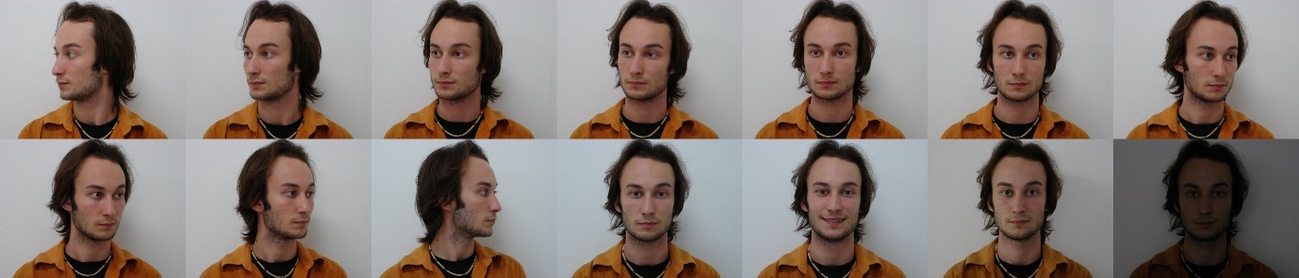
DATASET
We have used Brazilian face dataset.
Brazilian face database that contains a total of 2800 images, 14 images for each of 200 individuals and also there are 2 separate frontal images for each of the 200 individuals.
Each image of the same individual is consistently labeled with a name that begins with the same number, we have used this as a FaceID.

Slide 4
PROJECT DESCRIPTION
This project aims on enhancing face recognition systems to effectively identify individuals in images focusing more on occlusions and variations in facial orientation.
Leveraging existing face detection and recognition models to optimize performance.
Starting Point:
The baseline for this project consists of established face detection and recognition models.
Face detection : MTCNN(Multi-task Cascaded Convolutional Networks)
Face recognition : VGG-face (Visual Geometry Group)
Source: Github link

Slide 5
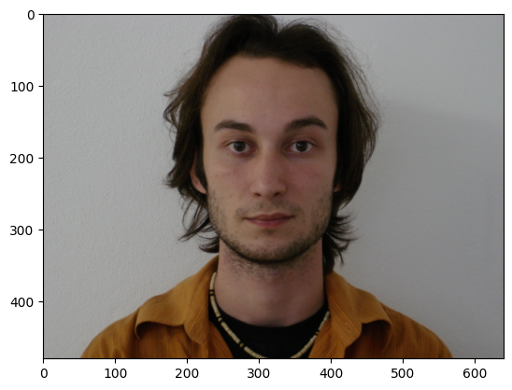
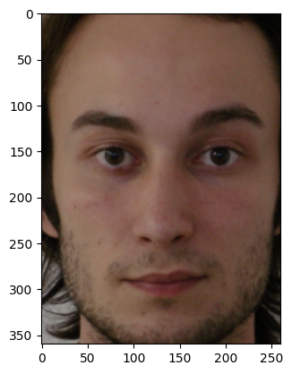
FACE EXTRACTION USING MTCNN
MTCNN works best for extracting faces from the image.
MTCNN

Slide 6
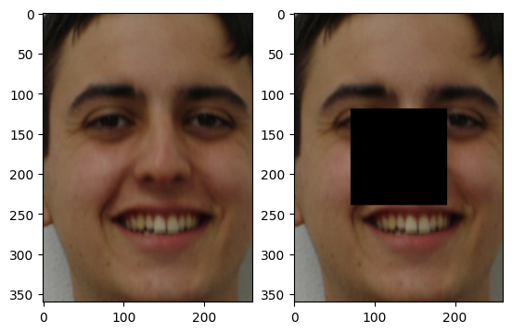
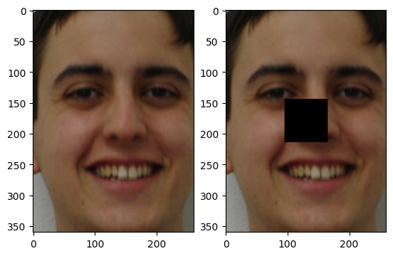
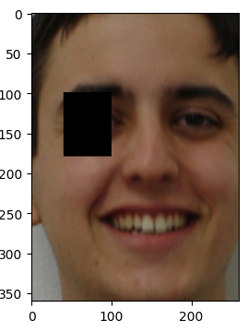
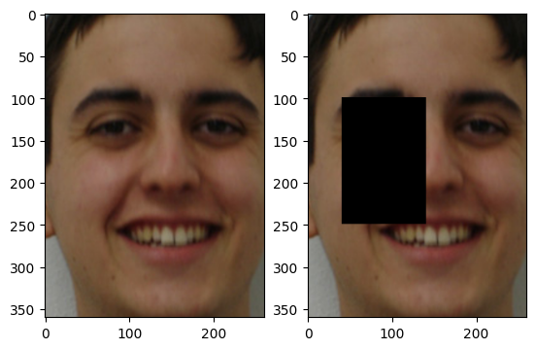
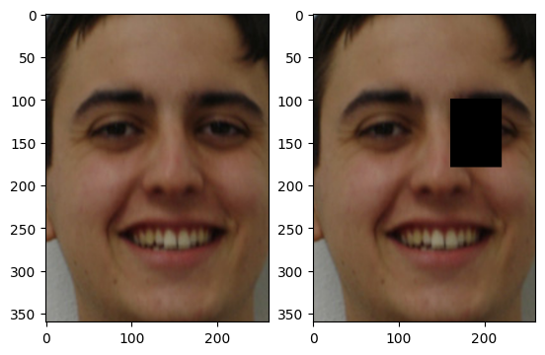
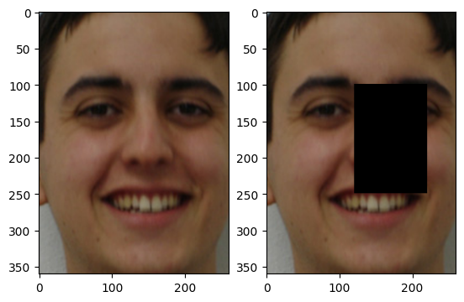
APPLYING OCCLUSION
We have used two types of occlusions, central and peripheral(left and right).
We introduced occlusions of 5% and 15% by manually setting pixels to zero for rectangular shape in the images.
5%
15%
5%
15%
5%
15%
Original face
Central occlusion
Left occlusion
Right occlusion

Slide 7
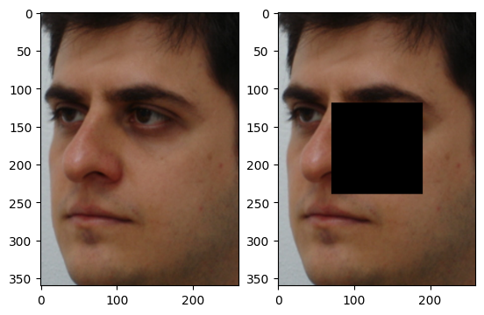
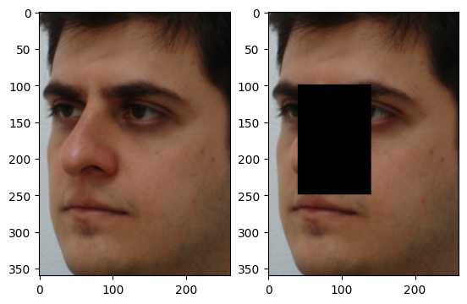
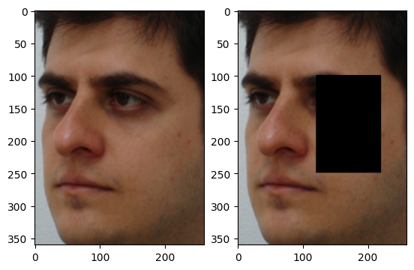
APPLYING OCCLUSION WITH ORIENTATION
We introduced occlusions of 15% by manually setting pixels to zero for rectangular shape in the images with different face orientation.
15%
15%
15%
Original face
Central occlusion
Left occlusion
Right occlusion

Slide 8
FACE REGISTER
Register1
Used 200 frontal faces for creating register, which are passed through MTCNN to extract only the faces.
The extracted faces were then passed through the pretrained VGGFace model to obtain a 512-dimensional face embedding, which was stored in a dictionary, where the key is the faceID and the value is the embedding.
Register2
Used 200 frontal faces , central occlusion faces, left occlusion faces and right occlusion faces each (in total 4 images for an individual)
These faces passed through the pretrained VGGFace model to obtain four 512 dimensional face embeddings for each individuals.
Then, the mean of the embeddings for an individual was taken, which was stored in a dictionary where the key is the faceID and the value is the average of embeddings.

Slide 9
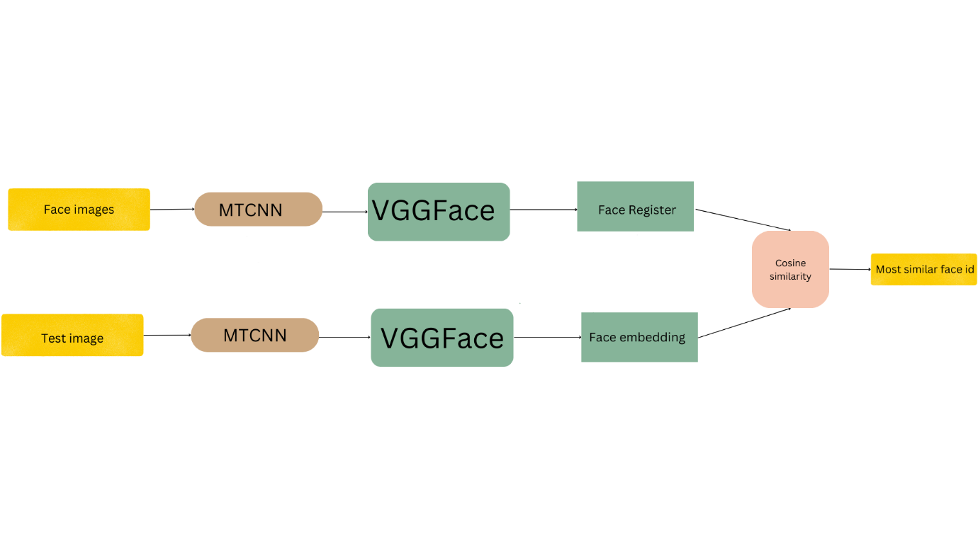
FACE RECOGNITION MODEL
Extracted faces from the image using MTCNN.
Created face register(Register1 and Register2).
Test images - images with different occlusions.
Embeddings of test images is compared with the face register, face ID of most similar face from register is assigned.

Slide 10
RESULTS –PRETRAINED MODEL WITH REGISTER1
Type of data | Accuracy | Type of data | Accuracy
Orientation | 94.5
5% central occlusion | 95.0 | 15% central occlusion | 78.5
5% right occlusion | 98.5 | 15% right occlusion | 80.5
5% left occlusion | 99.0 | 15% left occlusion | 91.0

Slide 11
COMPARISON - PRETRAINED MODEL
We have used the pretrained VGGFace model for the face recognition.The results are as follows.
Type of data | Register1 | Register2
 | Accuracy
Orientation | 94.5 | 94.3
15% central occlusion | 78.5 | 97.5
15% right occlusion | 80.5 | 98.5
15% left occlusion | 91.0 | 99.0
15% central occlusion+orientation | 59.5 | 74.0
15% right occlusion+orientation | 71.0 | 78.0
15% left occlusion+orientation | 63.5 | 74.0

Slide 12
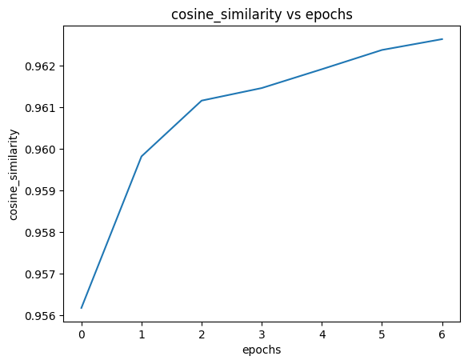
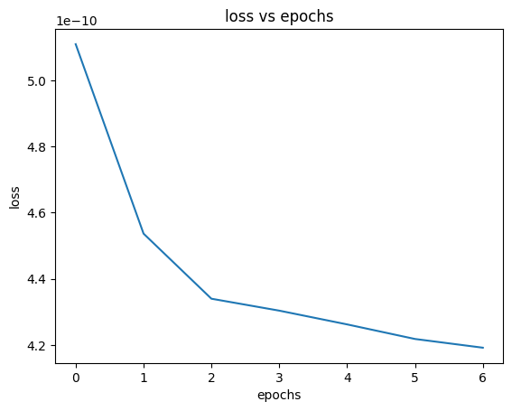
COMPARISON - TRAINED MODEL
We have trained one convolution layer of the VGGFace with 400 images from the dataset, then the predictions are done.

Slide 13
The results are as follows.
Type of data | Register1 | Register2
 | Accuracy
Orientation | 92.0 | 93.0
15% central occlusion | 85.5 | 98.5
15% right occlusion | 85.0 | 100
15% left occlusion | 92.0 | 99.5
15% central occlusion+orientation | 56.0 | 72.5
15% right occlusion+orientation | 69.0 | 77.0
15% left occlusion+orientation | 58.5 | 70.5

Slide 14
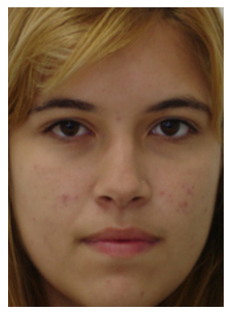
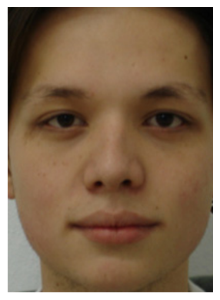
HEATMAPS
We can see that the deeper Convolution layers are focusing more on important features of the faces such as eyes , nose etc..

Slide 15
OBSERVATION
Found that utilizing Register2, which combines both regular and occluded faces, consistently resulted in better accuracy, highlighting the importance of incorporating diverse data in training.

Slide 16
CHALLENGES
Dependency issues
GPU Limitations: We faced challenges in training models with large images due to limitations in GPU capacity, affecting processing speed and scalability.
Quality vs. Size: Reduction of image size to address GPU constraints led to a trade-off between maintaining quality and preserving crucial facial details necessary for accurate recognition.

Slide 17
CONCLUSION
MTCNN works best for face extraction process.
VGGFace is able to identify crucial facial characteristics, enhances its accuracy in face recognition tasks with occlusions.
By addressing the challenges of occlusion and orientation variations, we aim to contribute to the development of more reliable and robust face recognition technology capable of operating effectively in challenging environments.

Slide 18
THANK YOU

